Slide 1
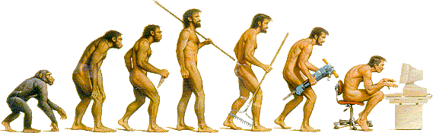
Object-Oriented Programming
with C++
Yuchi Huo @ CAD&CG Lab

Slide 2
Course contents
Introduction to object-oriented programming…
…with a solid software engineering foundation…
…aimed at producing and maintaining large, high-quality software systems.
Notes:
System hierarchy & abstraction, modulization, interface…

Slide 3
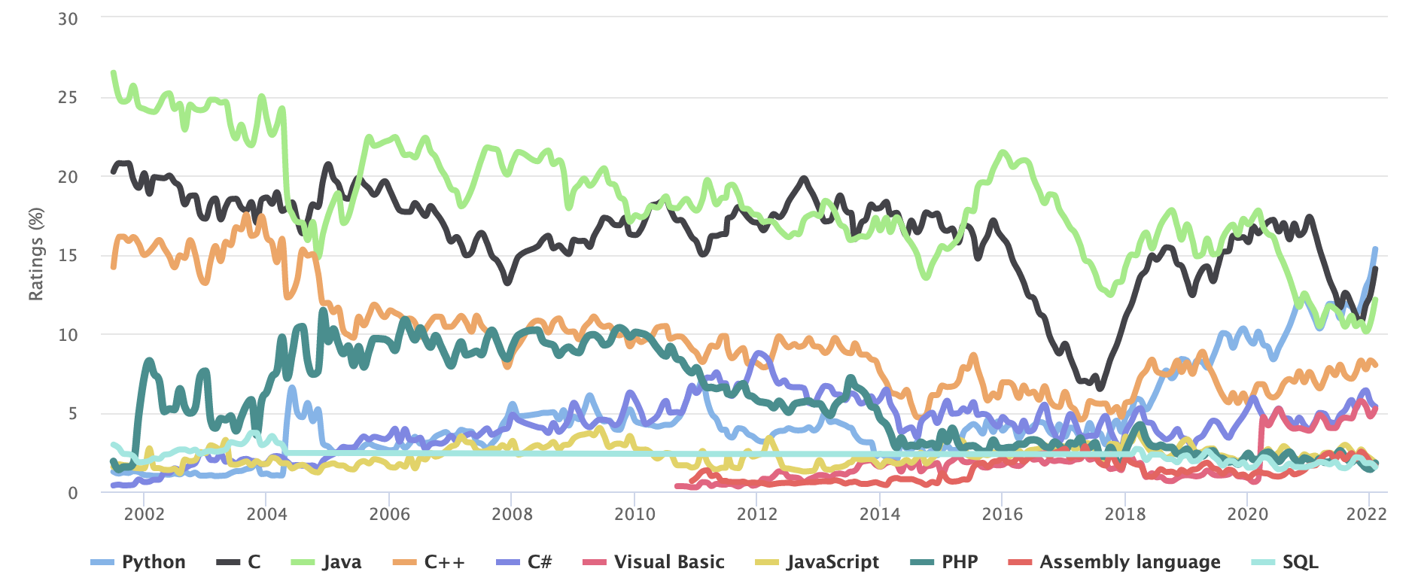
Ranked 4th on TIOBE Index

Slide 4
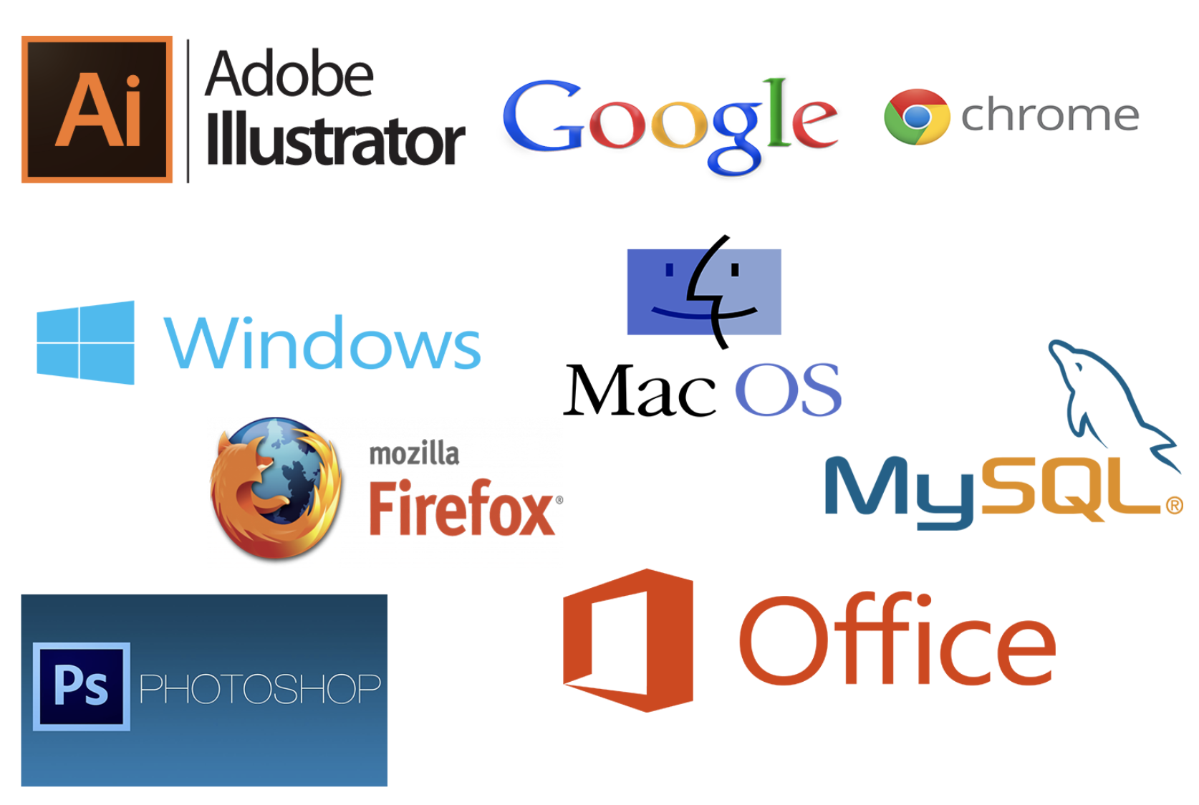
C++ Applications

Slide 5

C++ Applications

Slide 6
C++ Applications

Slide 7

C++ Applications「卡脖子问题」

Slide 8
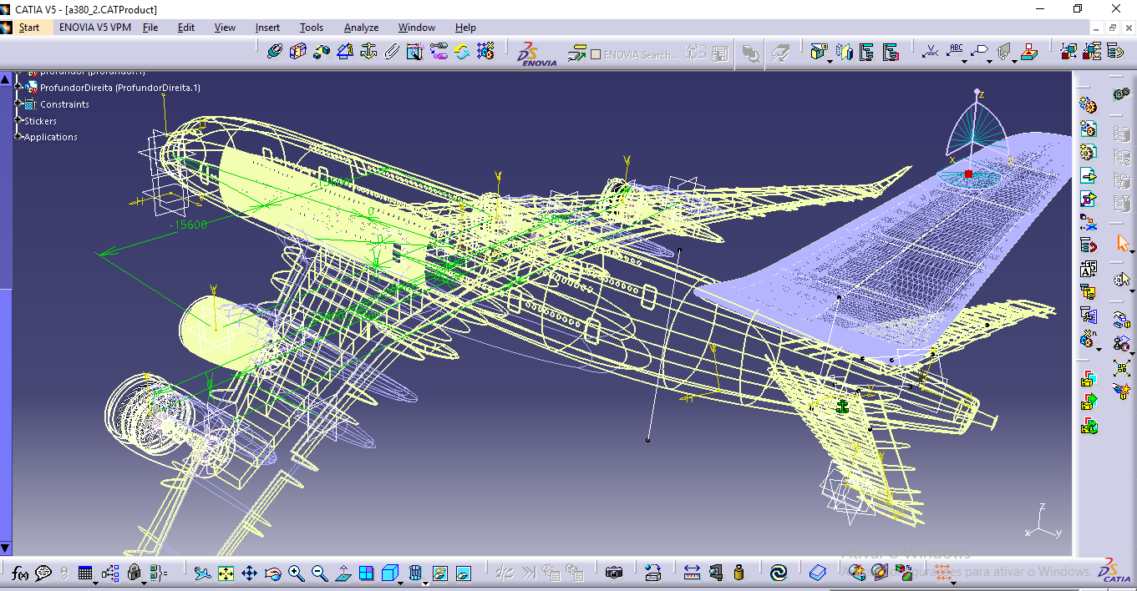
C++ Applications「卡脖子问题」

Slide 9
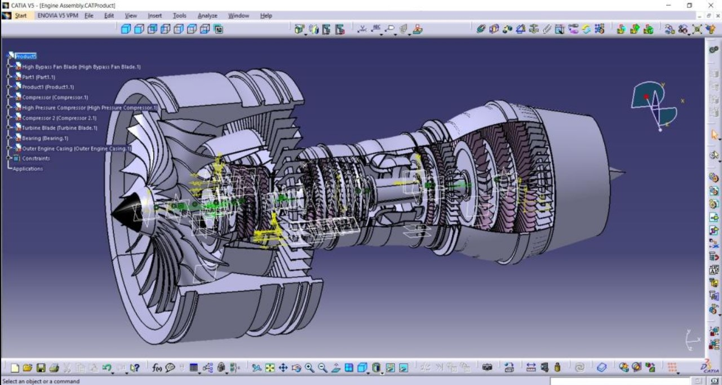
C++ Applications「卡脖子问题」

Slide 10
Buzzwords
responsibility-driven design
inheritance
encapsulation
iterators
overriding
coupling
interface
cohesion
template
collection classes
mutator methods
polymorphic method calls

Slide 11
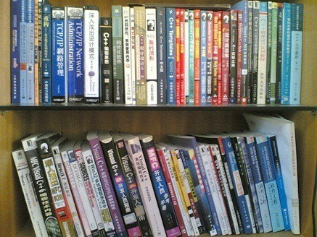
Textbooks

Slide 12
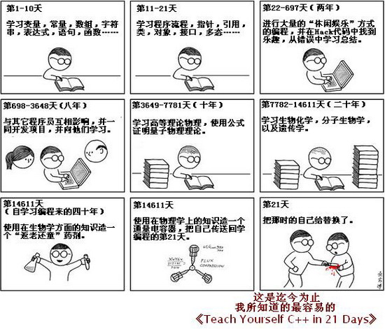

Slide 13
Textbooks
Thinking in C++, Vol.1&2
C++ Primer
References:
• The C++ Programming Language
• A Tour of C++
• Essential C++
• Effective C++
• Inside the C++ Object Model
• ……

Slide 14
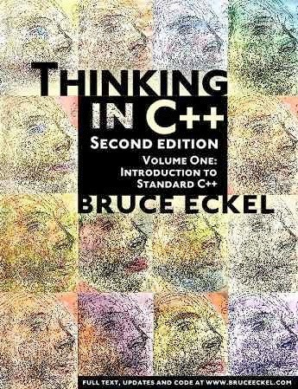
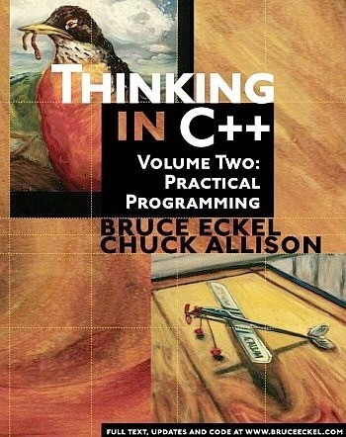
C++编程思想 机械工业出版社

Slide 15
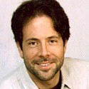
Bruce Eckel
BRUCE ECKEL is the author of “Thinking in C++”, which won the Software Development Jolt Award for best book of 1995. He's been professionally programming for 20 years and has been teaching people throughout the world how to program with objects since 1986. He was a voting member of the C++ Standards Committee.
http://mindview.net
6

Slide 16
Online Resources for C++
https://cppreference.com
https://isocpp.org/
https://www.youtube.com/user/CppCon

Slide 17
Assessment
Lab (50%, including the in-class quiz)
Announced in week 1, 3, 5, 7, 9, 11, and 13
Submit on-line (manually judged by TA)
The deadline is truly DEAD
Per day delay cost: 10% of the full score
Final exam (50%, on PTA)

Slide 18
Resources
Courseware (学在浙大)
Assignments (PTA)

Slide 19
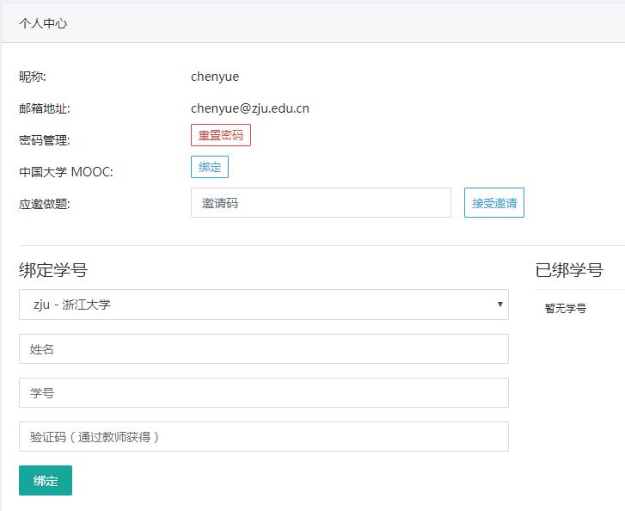
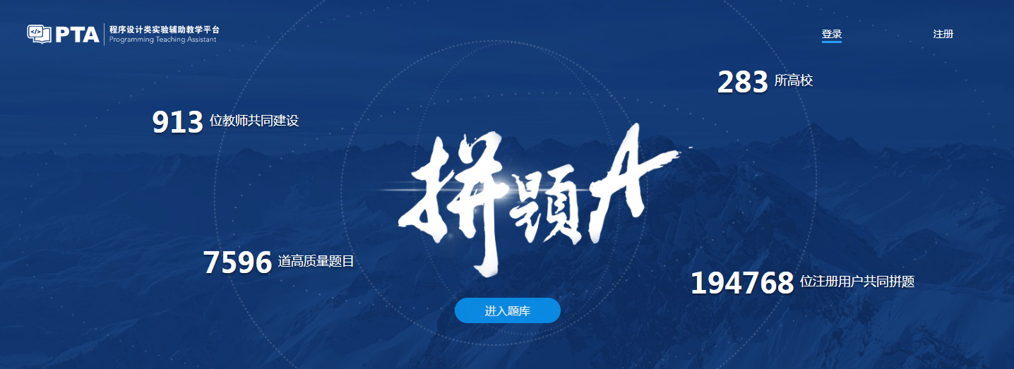
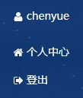
作业 (Homework Assignments)
Register and login at https://pintia.cn/
Bind your student ID with bind key
Enter

Slide 20
PTA绑定码：850585

Slide 21
Course policy
Academic honesty:
Students are fully responsible for their actions.
During homework, students can help each other through hints and explanations.
Copying code from anybody else is strictly forbidden.
https://conduct.berkeley.edu/integrity/

Slide 22
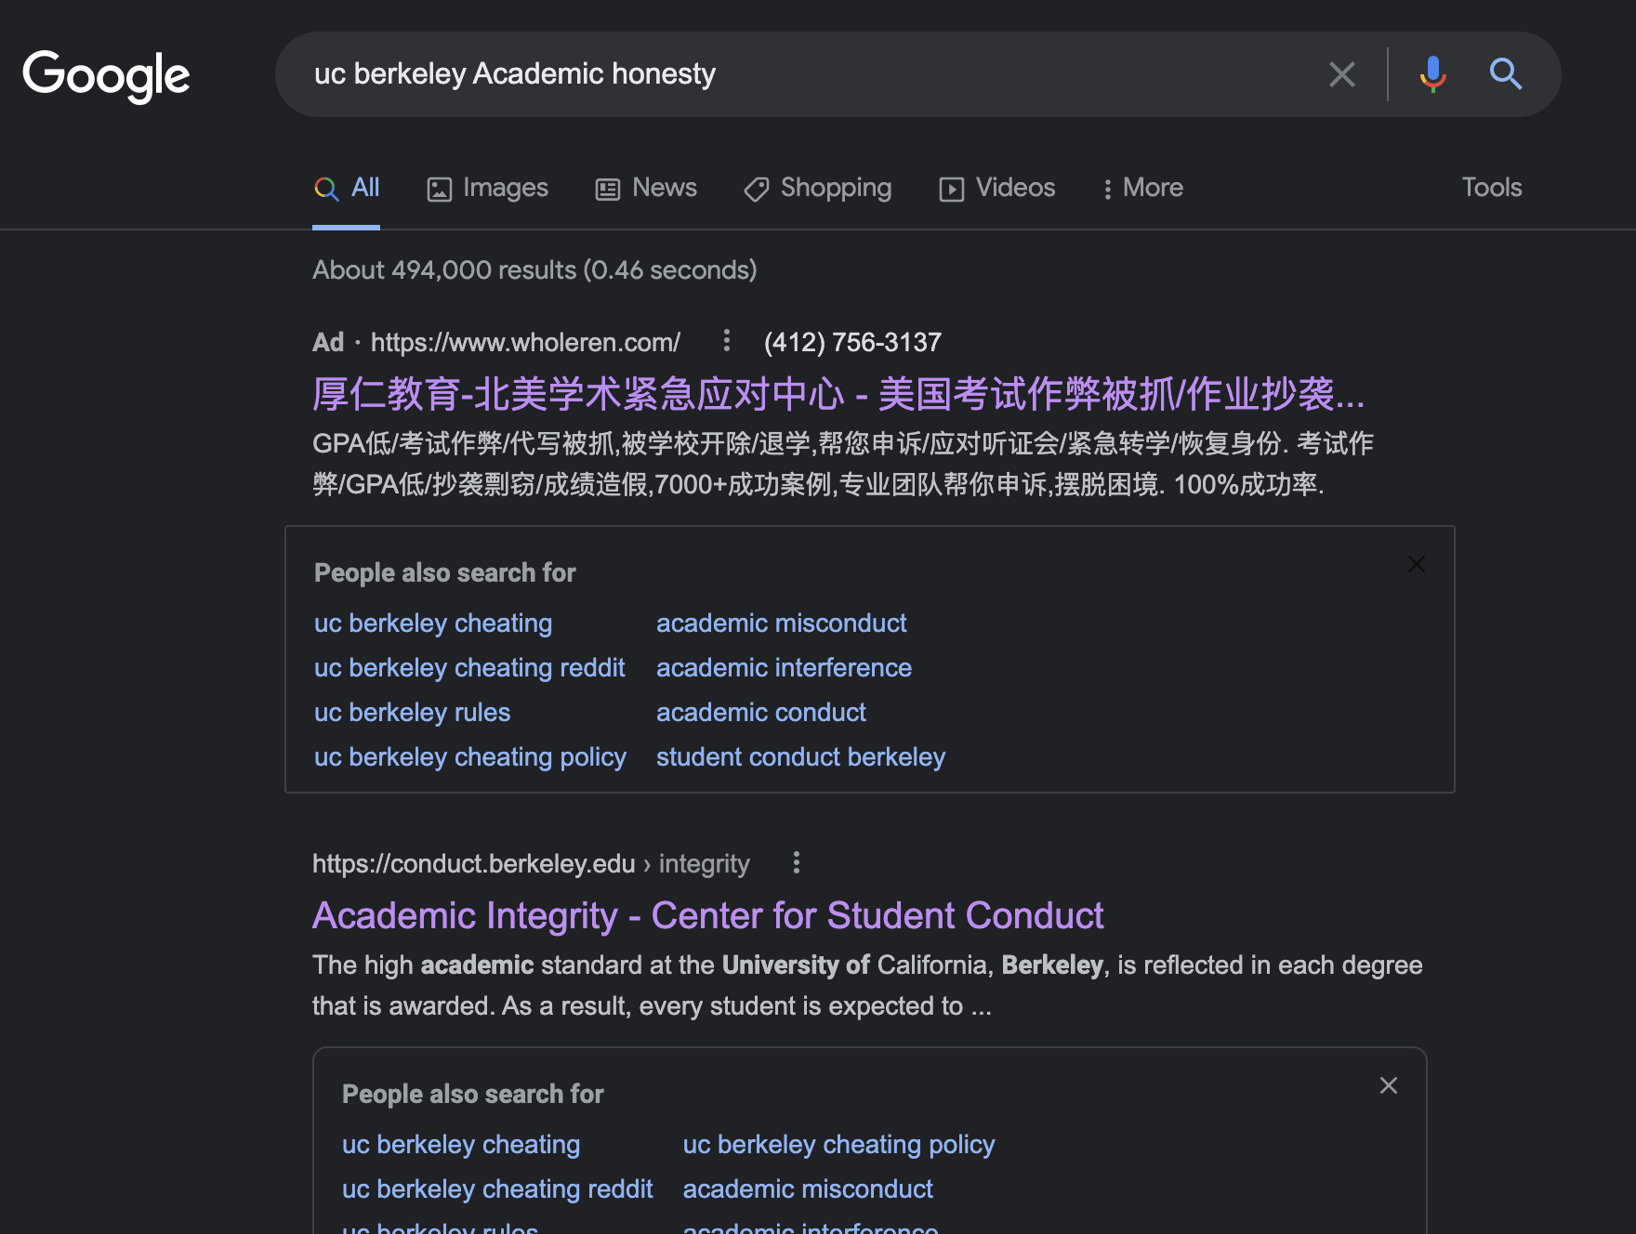
Course policy

Slide 23
E-mail rule
Contact info:
[ TA 胡崇浩] chonghao@zju.edu.cn
[ TA 孙川] 22421279@zju.edu.cn
[ me ] eehyc0@zju.edu.cn
Title starts with "[OOP]"
State your name and id in the text

Slide 24
Introduction to C++
The trip begins…

Slide 25
The first C++ program
#include <iostream> using namespace std;
int main()
{
cout << "Hello, World! I am " << 18 << " Today!" << endl;
return 0;
}

Slide 26


Development environment
Windows:
visual studio community
Linux, macOS:
g++, clang
visual studio code
Any compiler supports C++ standard well…

Slide 27
Read input
#include <iostream> using namespace std;
int main() {
int number;
cout << "Enter a decimal number: "; cin >> number;
cout << "The number you entered is " << number <<"." << endl;
return 0;
}

Slide 28
The C language
Strengths
Efficient programs
Direct access to machine, suitable for OS and ES
Flexible
Weakness
Insufficient type checking
Unsuitable for high-level applications
No direct support for oop

Slide 29

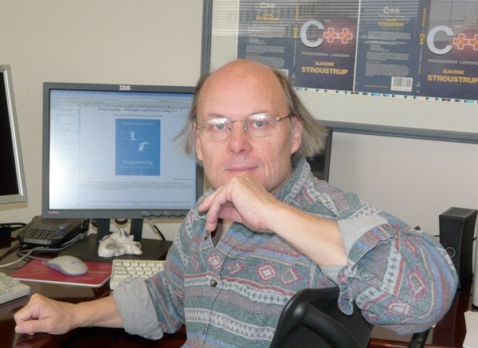
Bjarne Stroustrup
C++ was first designed and implemented by Bjarne Stroustrup, AT&T, early 1980’s
http://www.stroustrup.com/
Notes:
Danish, ACM/IEEE fellow

Slide 30
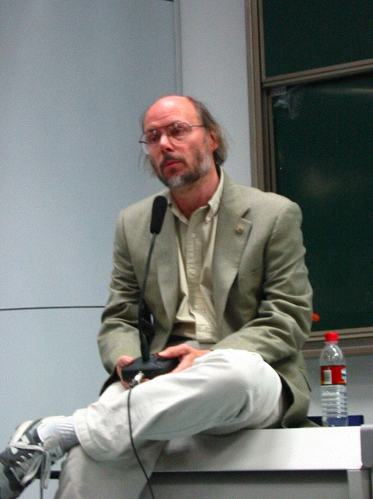
Oct. 2002, Stroustrup visited Zhejiang Univ.

Slide 31
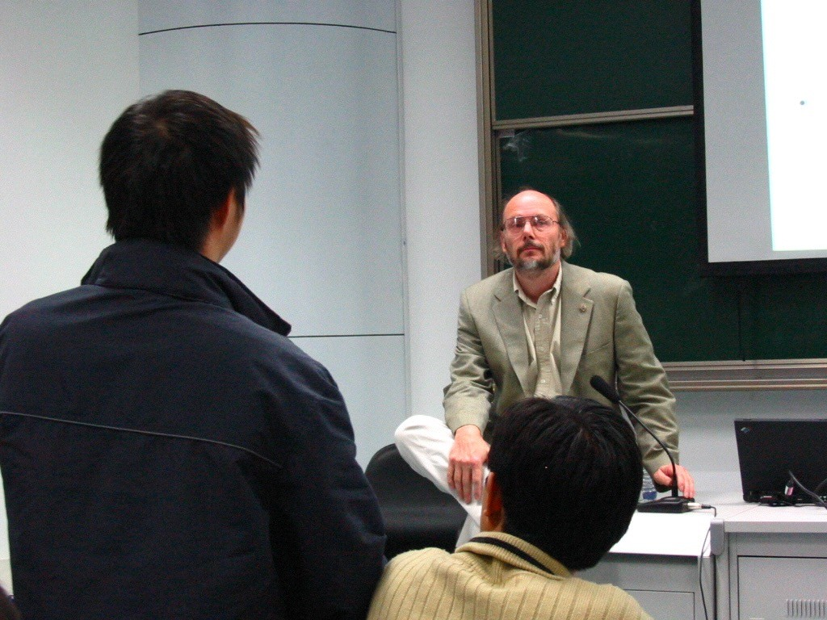

Slide 32
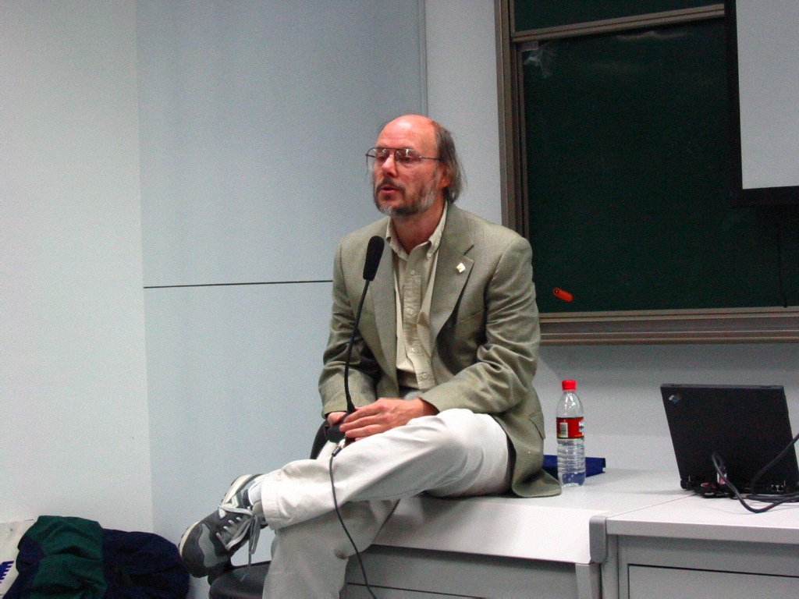

Slide 33
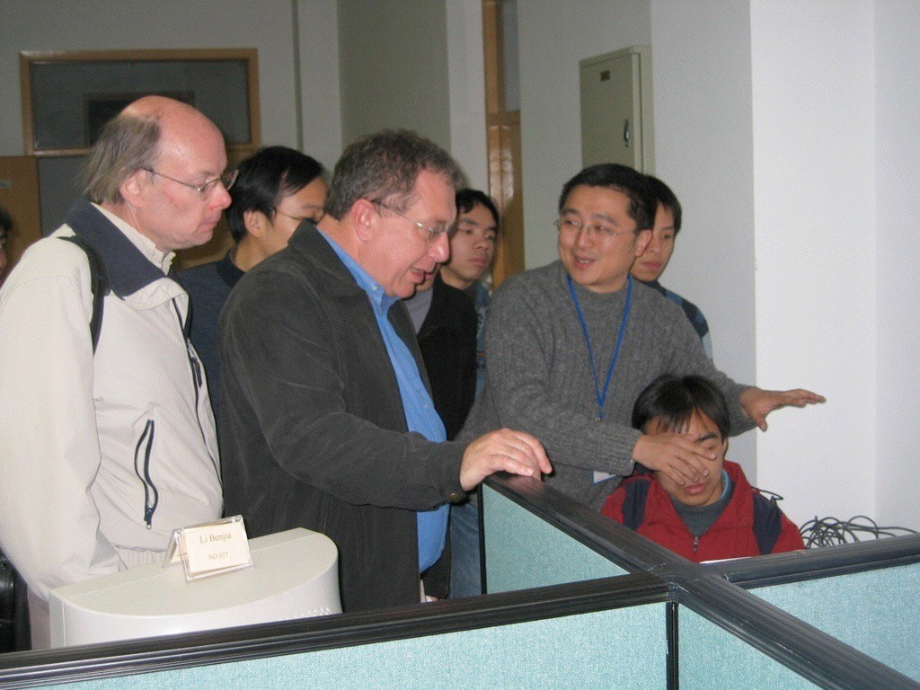
Stroustrup visited zju in 2005
Notes:
Adobe公司首席科学家Alexander Stepanov

Slide 34
C++ 之父：爱吃辣子鸡，C++20 会非常出色
https://www.infoq.cn/article/rv3SX2V8rtRaJj9B17xZ

Slide 35
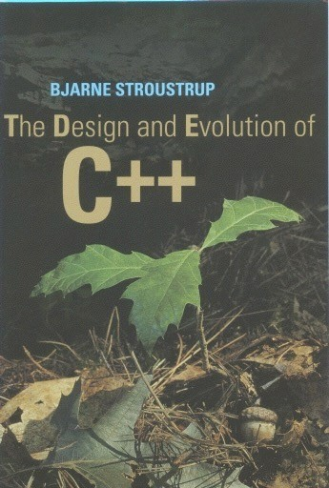
The Design and Evolution of C++
Bjarne Stroustrup, Addison-Wesley, ISBN 0-201-54330-3

Slide 36
Brief history of C++ (1)
1978: BS at Cambridge, UK. Simulation program in Simula
Supports classes, inheritance, and type check
Poor performance
http://www.engin.umd.umich.edu/CIS/course.des/cis400/simula/simula.html

Slide 37
Brief history of C++ (2)
1979: BS at AT&T Labs, Cpre, C w/classes
1980: most C++ features but virtual functions
1983: C++ w/virtual functions, named C++ by Rick Mascitti
1985: “The C++ Programming Language”
1990: ANSI C++ Committee ISO/ANSI
Standard C++ in 1998: ISO/IEC 14882 (http://www.open-std.org/jtc1/sc22/wg21/)

Slide 38
Brief history of C++ (3)
C++03, C++11, c++14, c++17, c++20
To be continued …

Slide 39
Goal for C++
To combine:
Flexibility and efficiency of C
Support for object-oriented programming (from Simula and SmallTalk)

Slide 40
C and C++
C
C++
C++ builds on C
Knowledge of C helps you in C++
C++ support more styles of programming
C++ provides more features

Slide 41
C++ improvements
Data abstraction
Access control
Initialization & cleanup
Function overloading
Streams for I/O
Constants (C99)
Name control
Inline functions(C99)
References
Operator overloading
Memory management
Support for OOP
Templates
Exception handling
Extensive libraries, STL

Slide 42
C++
C++ can be viewed as a “better” C
C++ → C=C+1
But...
C++ is not C
Focus on C++ as a language in its own right
C++ is a hybrid language, supports
Procedure-oriented programming
Object-oriented programming
Generic programming

Slide 43
Criticism of …
C++
https://en.wikipedia.org/wiki/C%2B%2B#Criticism
OOP
https://en.wikipedia.org/wiki/Object-oriented_programming#Criticism

